Slide 1




Sound system basics
Hayward church of christ

Slide 2
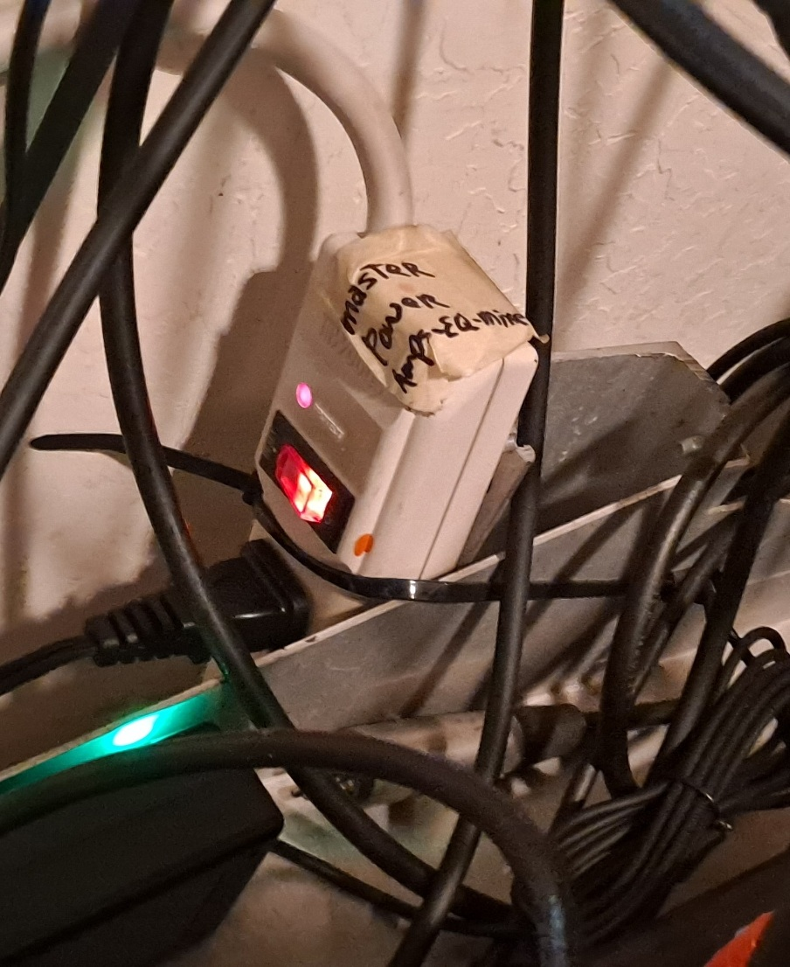
Power up!
Under the little window behind the mixer is the main power button. You will normally only have to turn this on or off. All devices are powered by this button
The only exceptions are the battery operated or wireless devices. They need to be turned on individually.

Slide 3
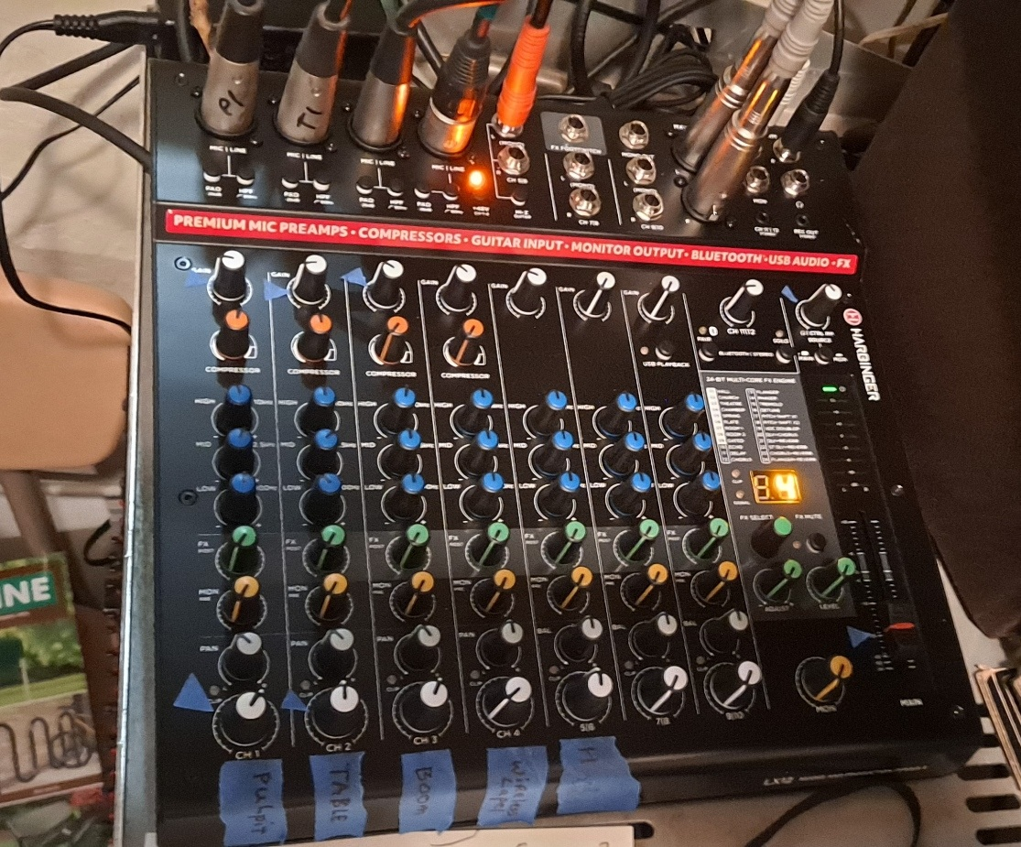
Make some noise!
This is the mixer. All of the sound inputs are controlled through here.
Microphones
Bluetooth music
Computers, etc.
Outputs go to the amplifiers below the mixer. One controls the auditorium, the other controls the nursery, training room and lobby.

Slide 4
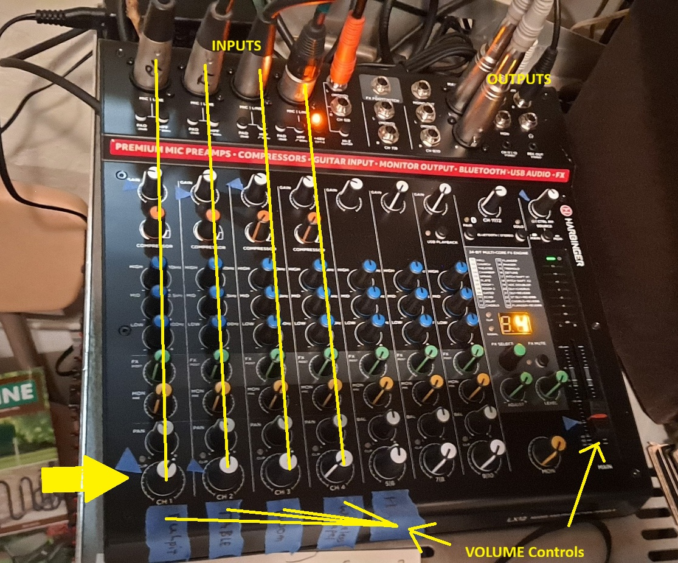
Make some noise!
Below each input are the controls for that input. The bottom row should be the only concern.
Big yellow arrow: shows the white knobs on the bottom row.
There is a “Master” volume control on the right. It’s proper location is marked. Avoid controlling microphones with this control. Feedback or low volumes will be hard to fix.

Slide 5
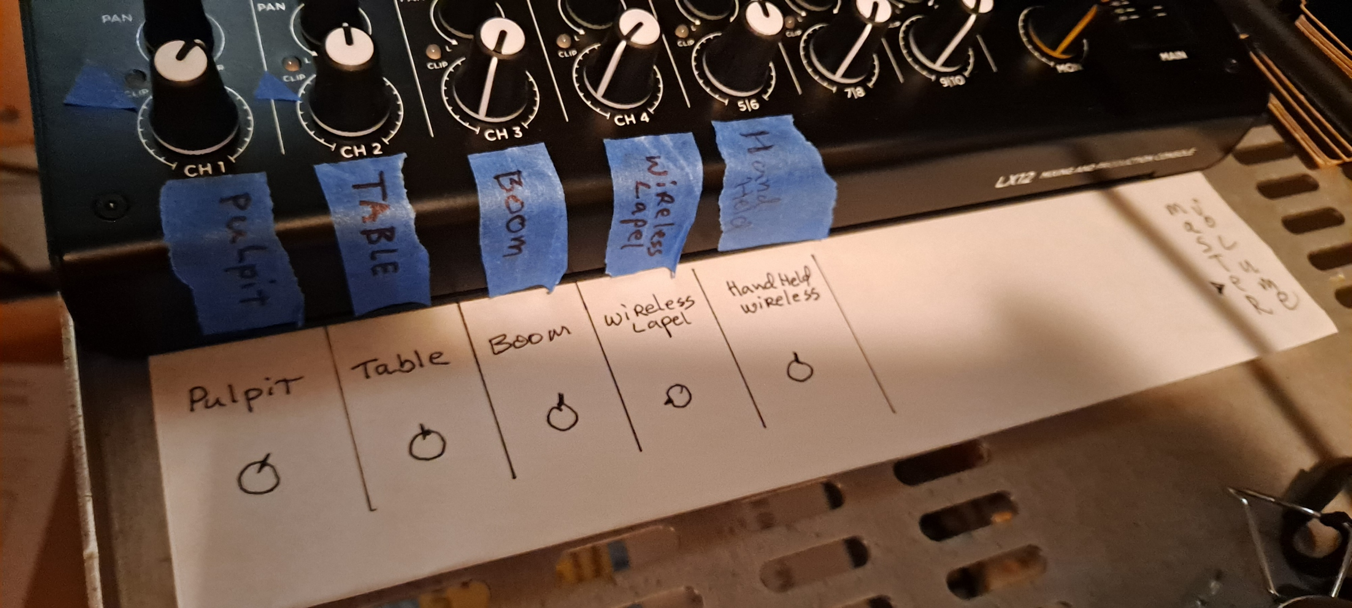
Make some noise!
Each of these knobs is a volume control for a device.
They are tagged with their controlled device. The template shows common levels.
Example: If you can’t hear the pulpit microphone, check that this is in the correct position. If it still has no volume, check the “master” volume. It should be at the blue mark.
And… is the power switch on?

Slide 6
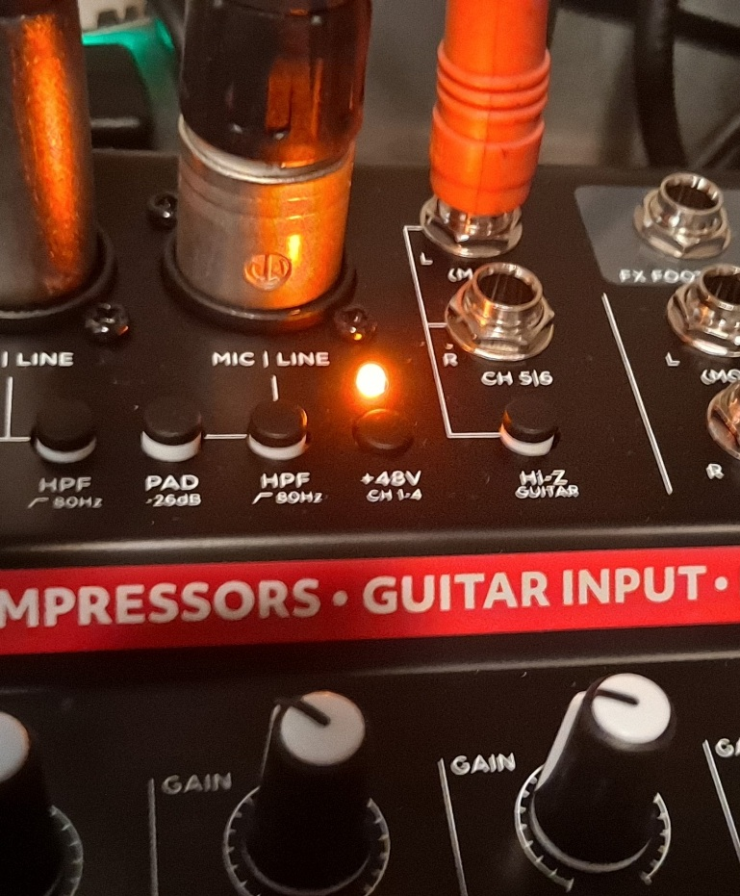
Make some noise!
If neither of the front microphones are working, check that this light on the mixer is on… If not, push the +48v Button. The light should turn on.

Slide 7
Feedback . . .
Feedback is when a microphone hears the speaker and starts to re-amplify the sound. This produces a very loud screaming noise and eventually destroys speakers and eardrums. Very Bad…….
The quick response is to turn down the microphone which is in use until the squeal subsides. If nothing changes, turn down the unused microphone and restore the one in use.

Slide 8
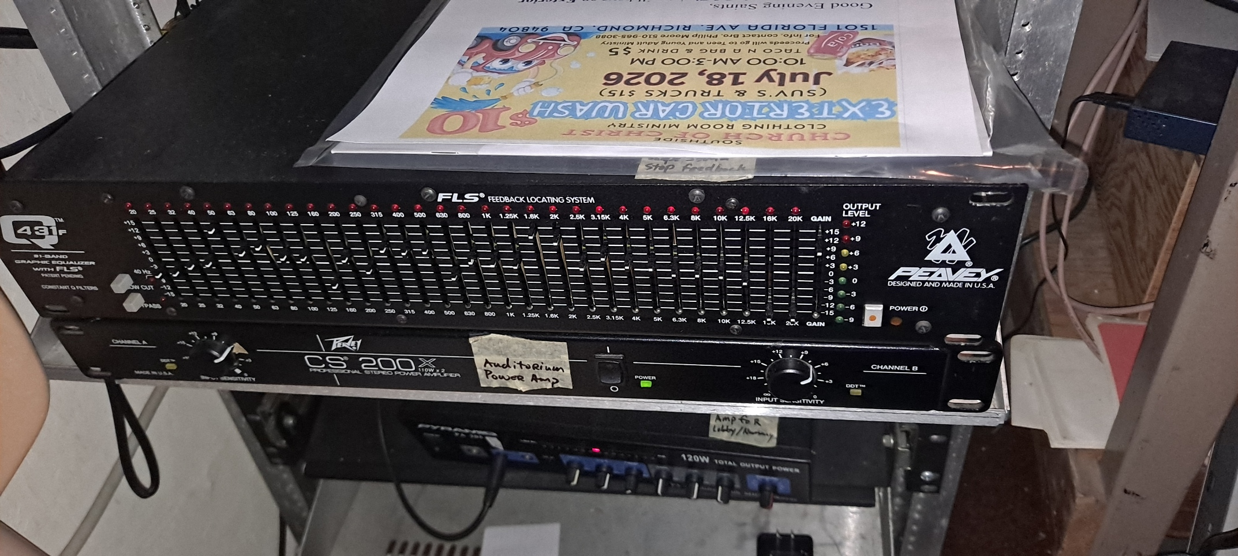
Feedback . . .
This area below the mixer is usually untouched. It’s all set up, but occasionally little fingers wander by and touch or move buttons.
This can be bad….
The top device is a graphic equalizer and anti-feedback device.
Let’s take a closer look….

Slide 9
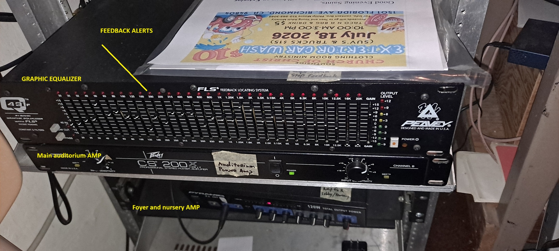
Feedback . . .
This area below the mixer is usually untouched. It’s all set up, but occasionally little fingers wander by and touch or move buttons.
This can be bad….
The top device is a graphic equalizer and anti-feedback device.

Slide 10
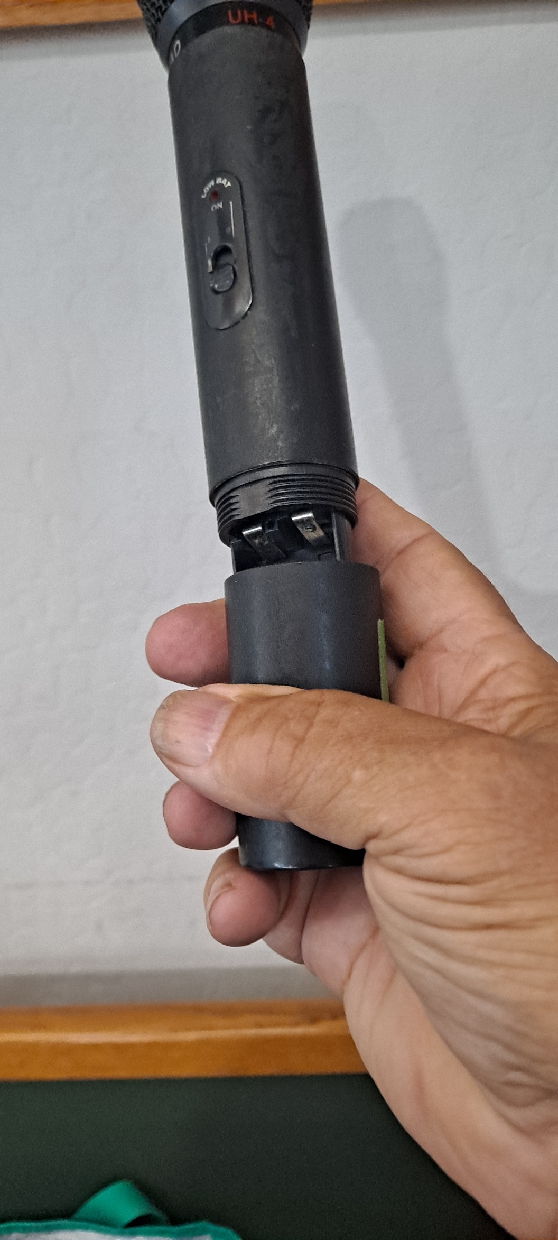
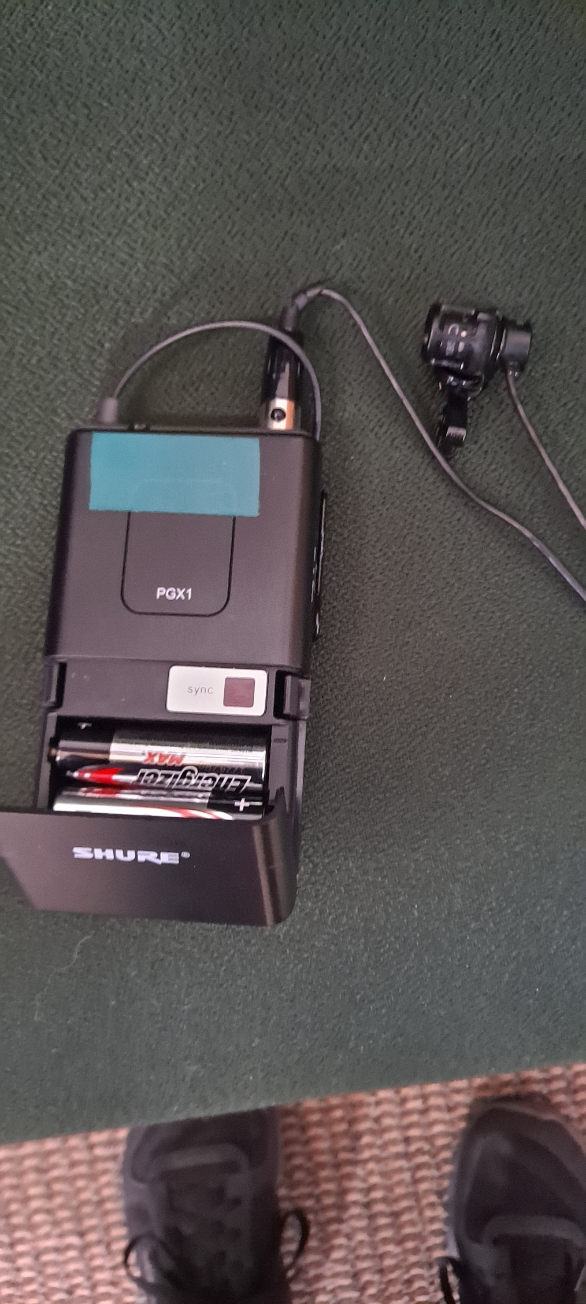
Wireless mics
These all take batteries… or are rechargeable.

Slide 11
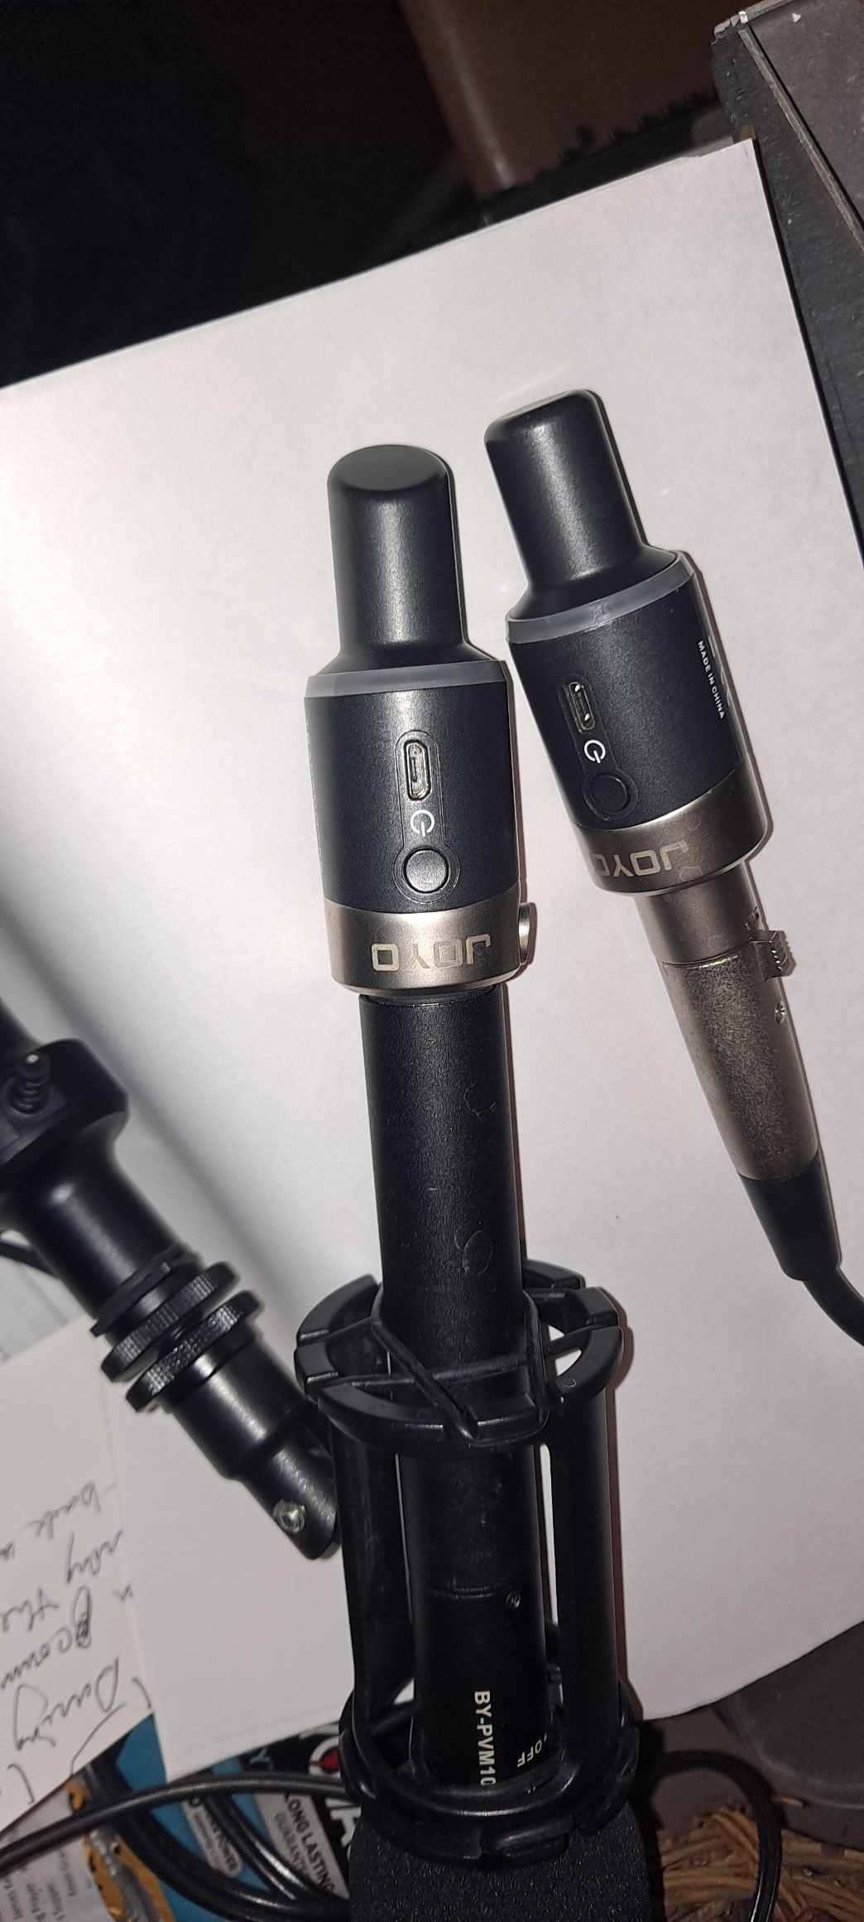
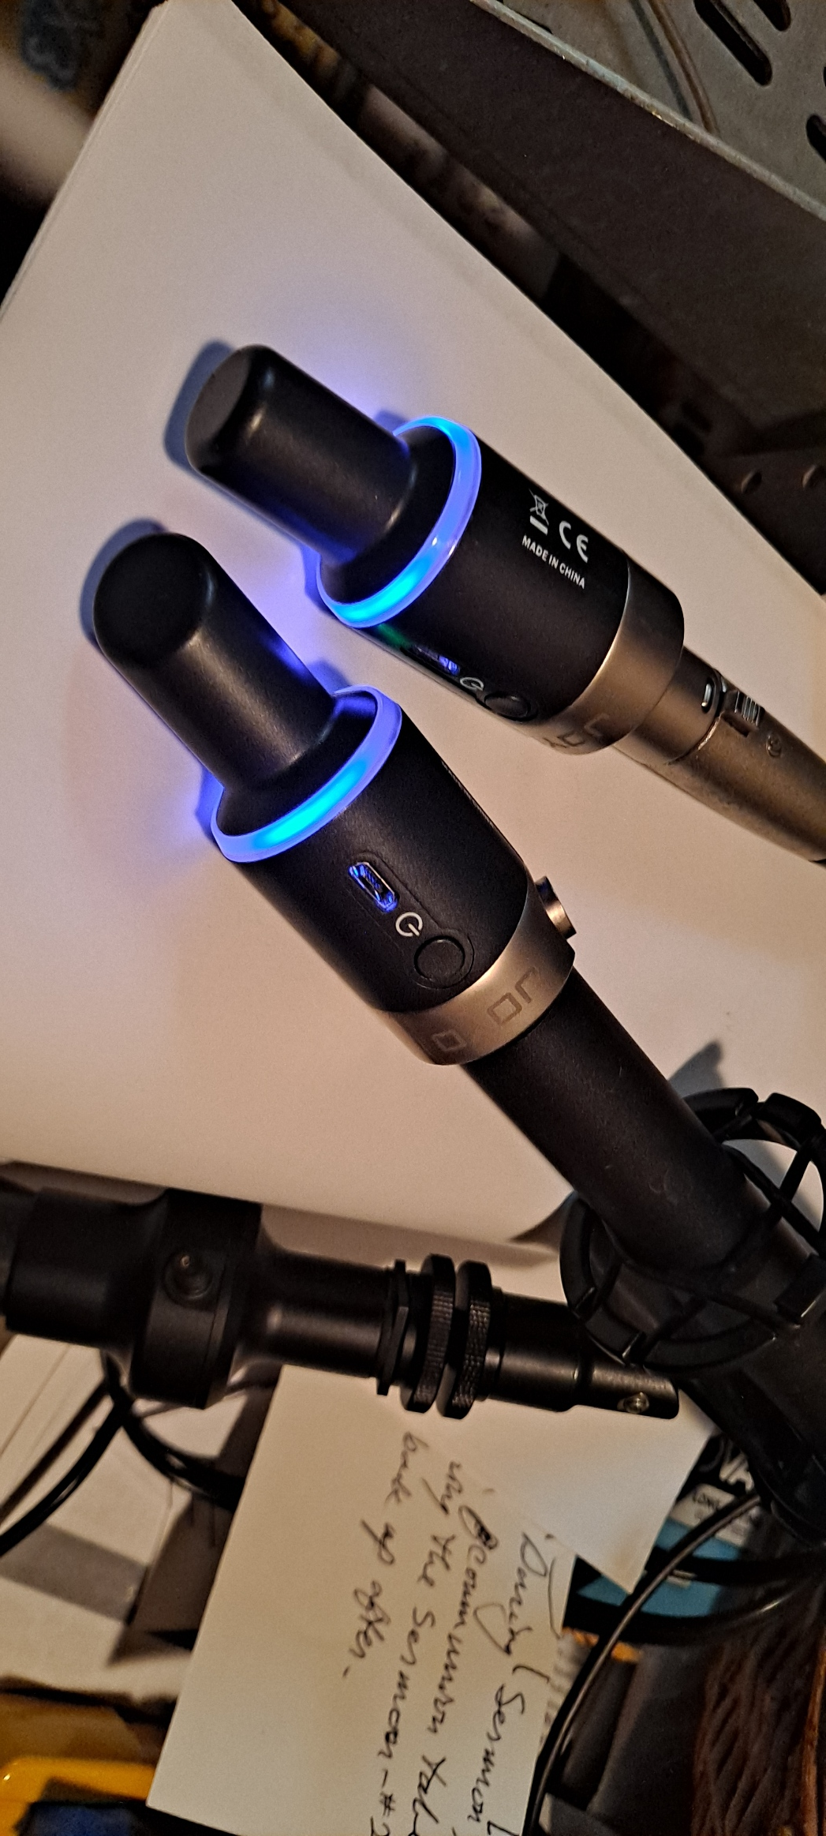
Wireless mics
These all take batteries… or are rechargeable.
Be sure to turn them off after use, or you may run out at a bad time.
The boom mic and receiver need to be charged also. There is a AA battery in the boom mic. Also. (with a power switch)

Slide 12
The hard part
No amount of reasonable equipment will work if the speaker doesn’t speak up and point their face at the microphone.
There has to be a sound to amplify.
Your brilliant presentation is impeded if some can’t hear it.

